Slide 1





Azure & DevOps Study Group
Free Live Webinar
AZ-900: Microsoft Azure Fundamentals
Module 1: Introduction to Azure Concepts and Core Azure Services
25/10/2021
07:00 PM UK

Slide 2
Module 1:
Introduction to Azure Concepts and Core Azure Services

Slide 3
Module 1: Intro
Introduction and Module Overview

Slide 4
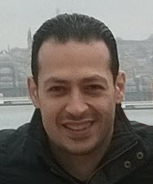





About The Presenter
Mohamed Radwan
Principal DevOps Consultant/ NTT DATA UK. Over 19 years of experience
Microsoft Azure DevOps & GitHub MVP for 10 years
Helped more than 50 enterprise companies some of them from the Fortune 500
Presented hundreds of sessions in many conferences & events around the globe
Developed many tools and frameworks on GitHub and Azure DevOps Marketplace
mohamedradwan.com
Notes:
How Cloud Can Help DevOps Transformation

Slide 5


Module 1: Overview
This lesson will cover
Speakers and Lessons of This Module
Lessons and Allocated Time of This Module
Overview About Each Lessons in This Module
Notes:
How Cloud Can Help DevOps Transformation

Slide 6
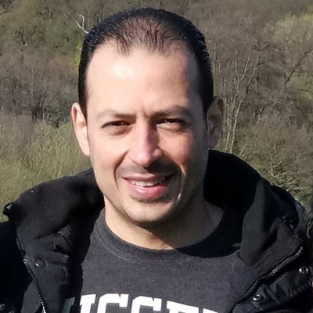

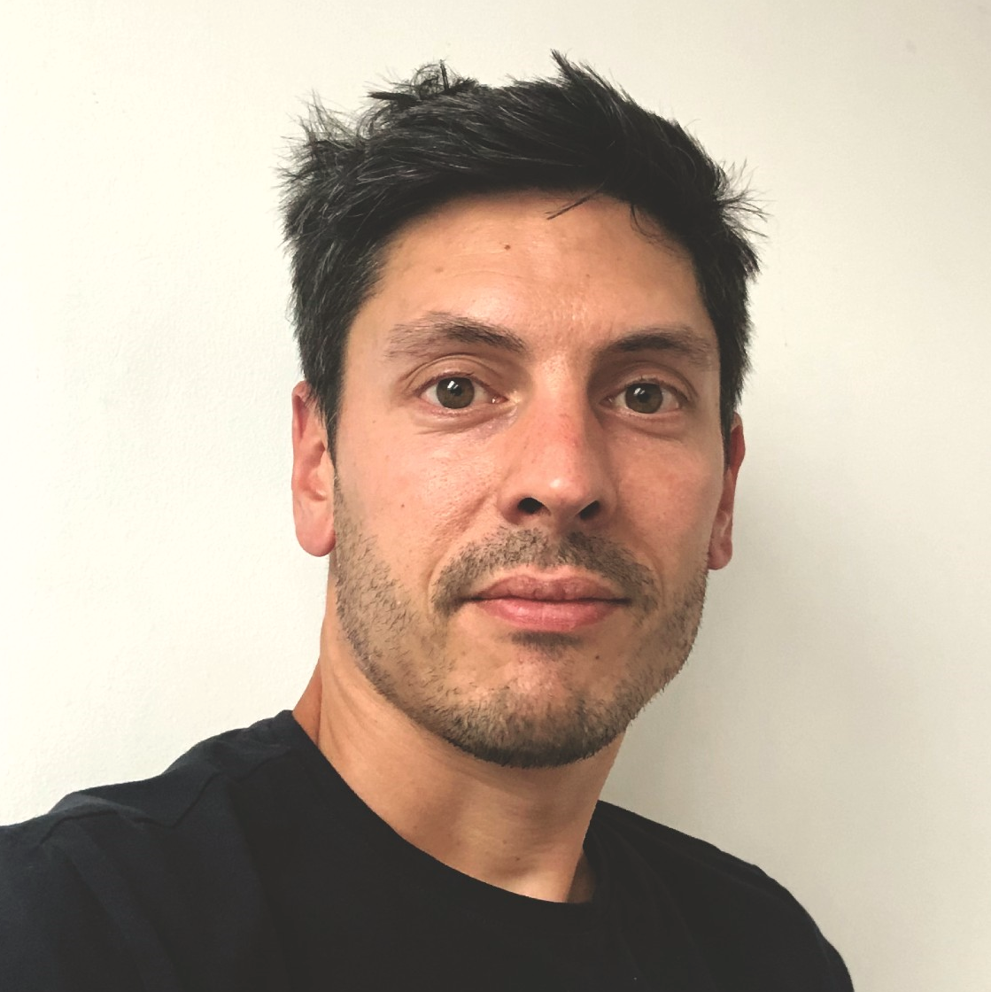
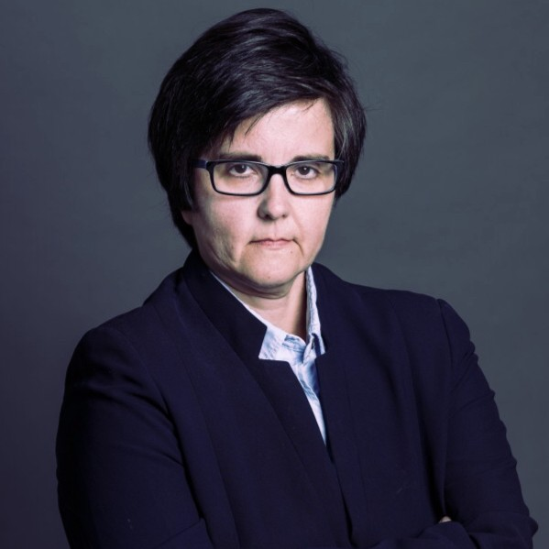
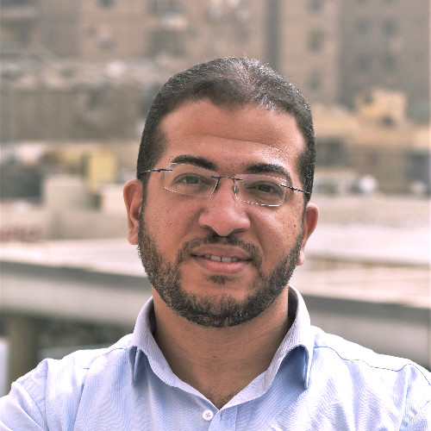


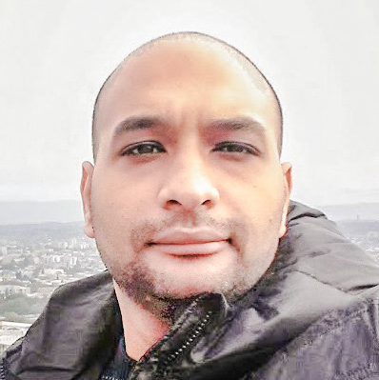
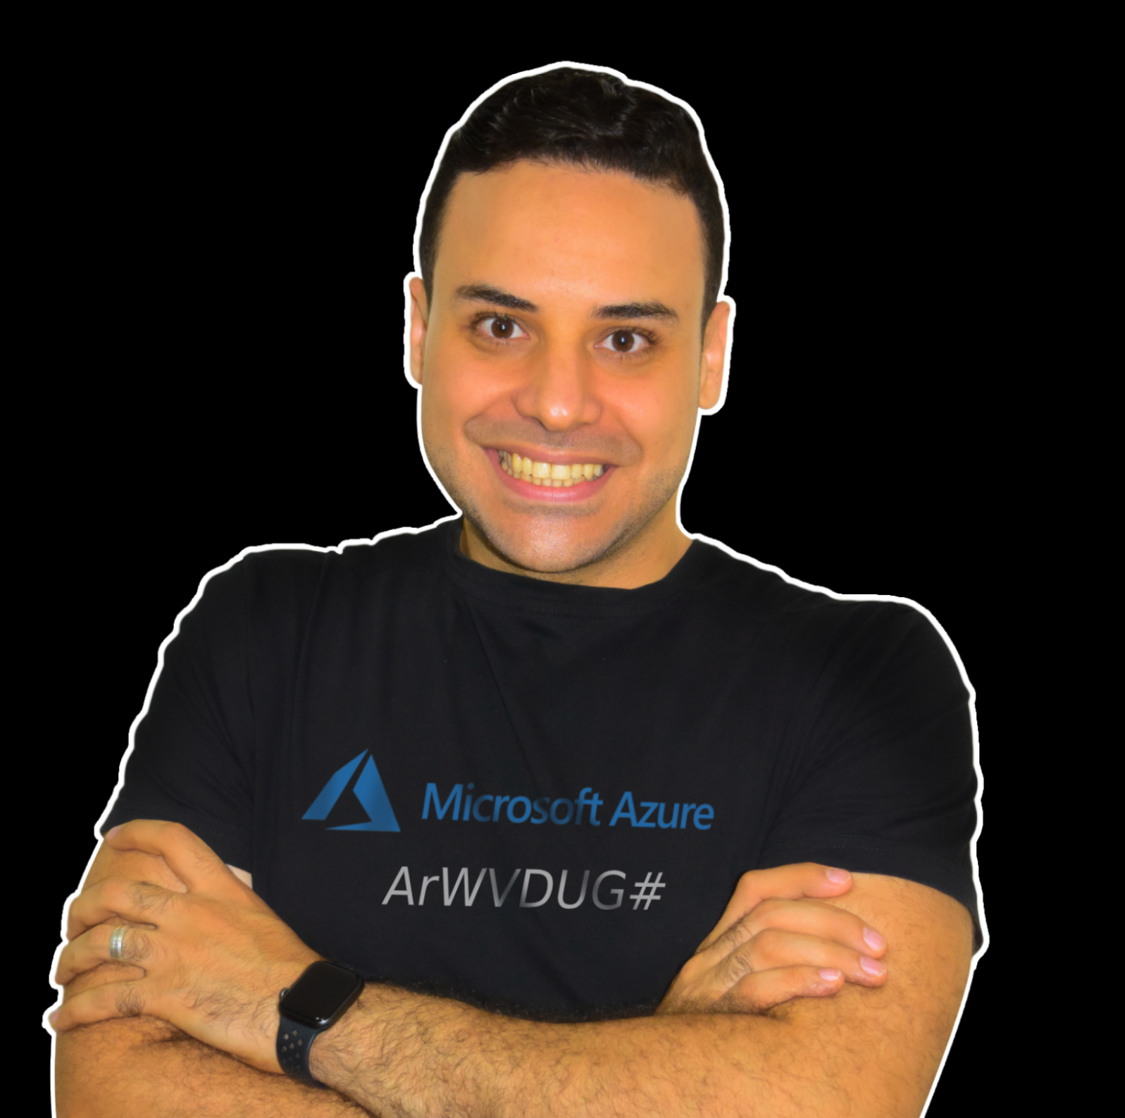
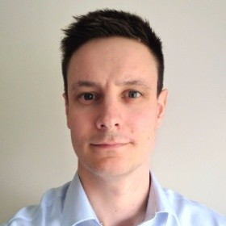



Module 1: Speakers and Lessons
Mohamed Radwan
Principal DevOps
NTT DATA UK
UK/London
Aaron Hughes Senior Consultant
Hitachi Solutions
UK/Plymouth
Sebastien Boinot
Principal DevOps
NTT DATA UK
UK/London
Paloma Giraudo Infra&Security Manager
Secuirtypyme
Spain/Madrid
Muhammad Gouda Senior App Dev Consultant
Microsoft
Egypt/Cairo
(0) Introduction and Module Overview
(1) Cloud Concepts
(2) Understanding Azure Architectural Components
(3) Introduction to Azure compute Services and Virtual Machine VS. App Service
(4) Understanding Azure Container Services, Function and Virtual Desktop
Mohammed Adel Senior Cloud Engineer
MAF Retail
UAE/Dubai
Mahmoud A. ATALLAH Sr. Cloud Architect
Bespin Global MEA UAE/Abu Dhabi
Phil Cole
D-365/Power Platform
DXC Technology
UK/London
Mario Dietner
Senior Technologist and AI
Trivadis AG
Switzerland/Zürich
(5) Azure Networking Services Fundamentals
(6) Azure Storage Services Quick Start
(7) Introduction to Azure Cosmos DB and Azure SQL Database
(8) Overview of Azure Database and Analytics Services

Slide 7
Module 1: Agenda and Allocated Time
Lesson No | Speaker Name | Lesson Title | Allocated Time (UK)
0 | Mohamed Radwan | Introduction and Module Overview | 07:00 – 07:05 PM
1 | Aaron Hughes | Cloud Concepts | 07:05 – 07:35 PM
2 | Sebastien Boinot | Understanding Azure Architectural Components | 07:35 – 07:55 PM
3 | Paloma Giraudo | Introduction to Azure compute Services and Virtual Machine VS. App Service | 07:55 – 08:15 PM
4 | Muhammad Gouda | Understanding Azure Container Services, Function and Virtual Desktop | 08:15 – 08:35 PM
Break |  |  | 08:35 – 8:45 PM
5 | Mohammed Adel | Azure Networking Services Fundamentals | 08:45 – 09:10 PM
6 | Mahmoud A. ATALLAH | Azure Storage Services Quick Start | 9:10 – 09:30 PM
7 | Phil Cole | Introduction to Azure Cosmos DB and Azure SQL Database | 09:30 – 09:50 PM
8 | Mario Dietner | Overview of Azure Database and Analytics Services | 09:50 – 10:10 PM
Notes:
How Cloud Can Help DevOps Transformation

Slide 8
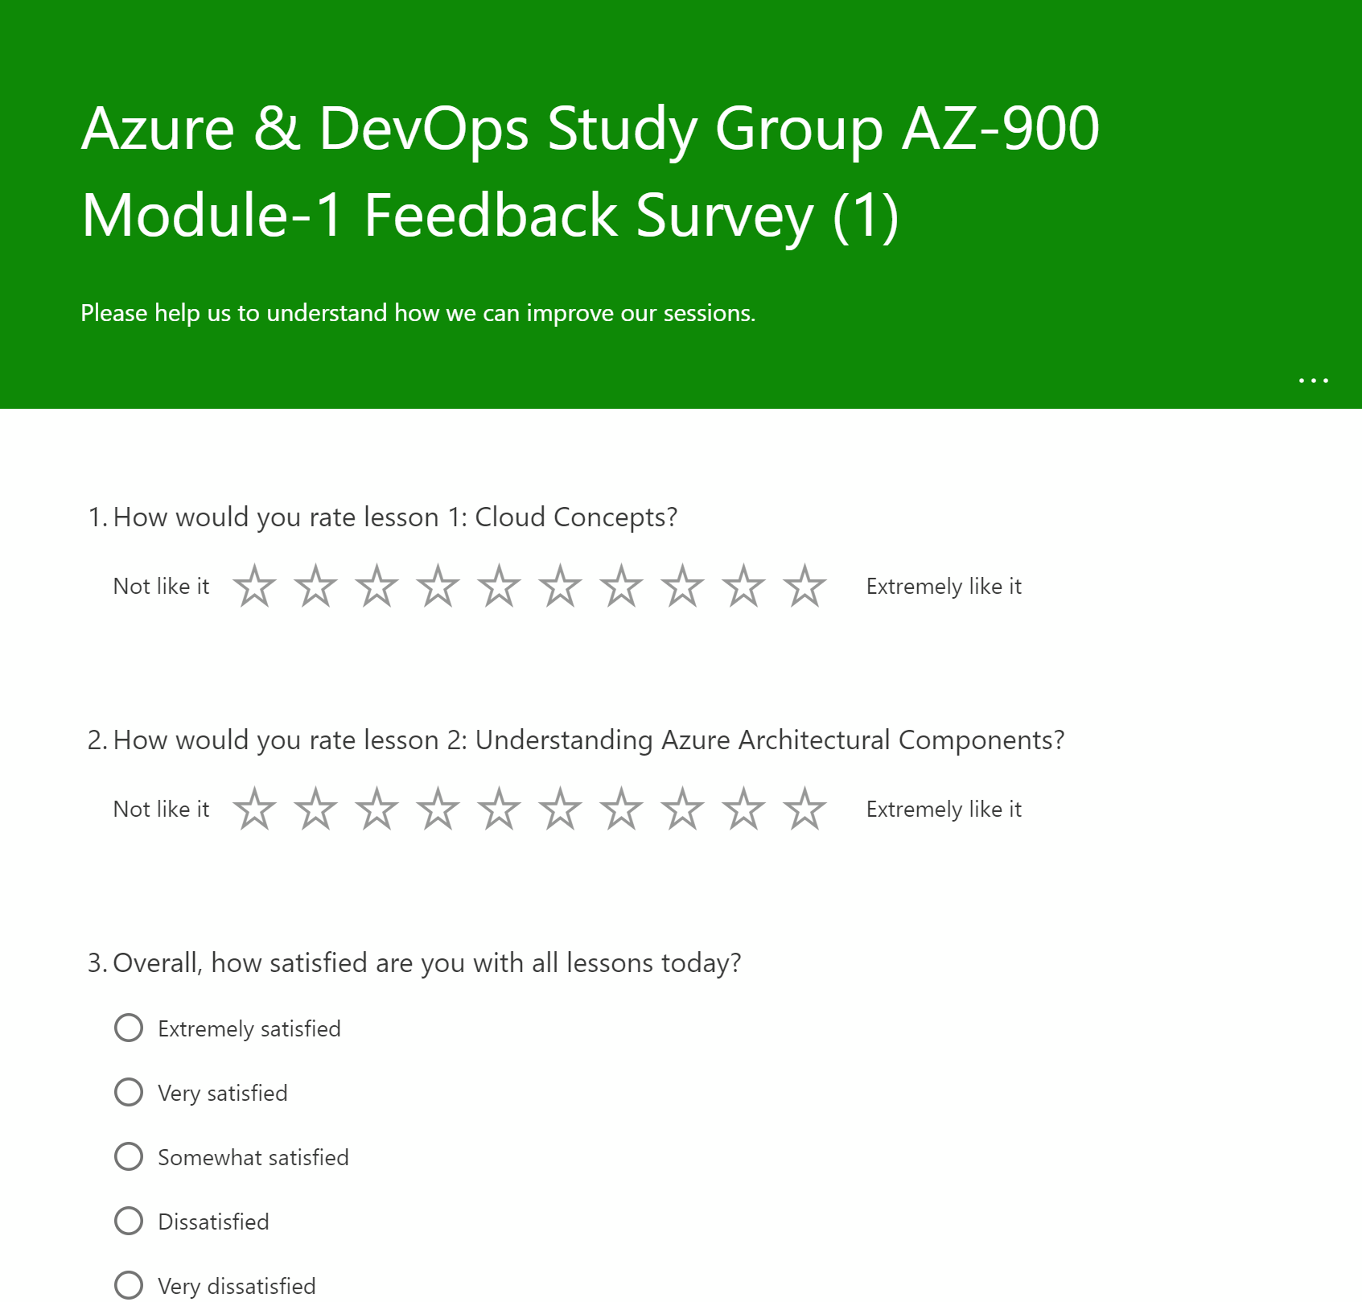
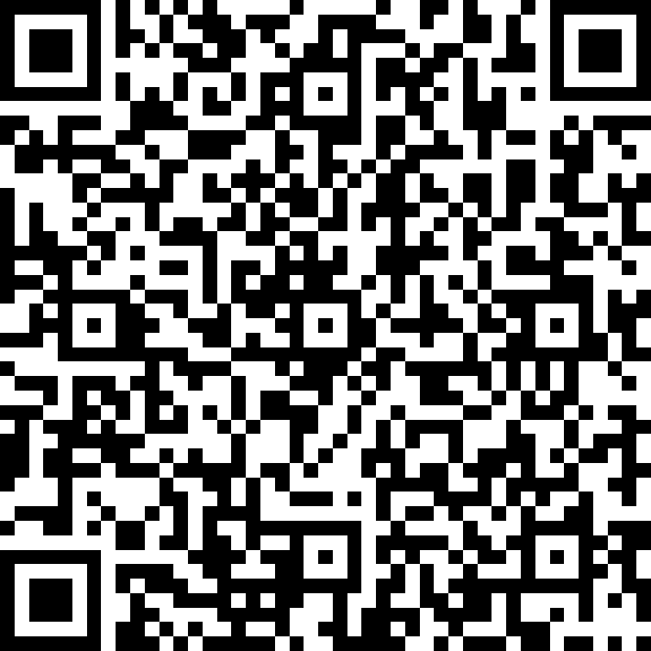
Module 1: Feedback Survey
Notes:
How Cloud Can Help DevOps Transformation

Slide 9

Summary
This lesson has covered
Speakers and Lessons of This Module
Lessons and Allocated Time of This Module
Overview About Each Lessons in This Module
Next Lesson:
( 1 ) Cloud Concepts
Notes:
How Cloud Can Help DevOps Transformation

